Slide 1
1.1 Multiplication tables

Slide 2
Introduction
In this topic, we will
Review the multiplication tables
Understand the need
Make some observations that may make it less boring

Slide 3
Multiplication tables
A student once complained that the midterm was too difficult:
I pointed out the question required you to calculate 0.7 × 0.5
I asked “what is seven times five?”
The response:
“Seven is three plus four,
three times five is fifteen,
four times five is twenty,
so seven times five is fifteen plus twenty or thirty five.”
Great answer for grade six…

Slide 4
Multiplication tables
Why learn them now?
We will be working with systems of linear equations
You will see examples where you must calculate
As we work through examples, you have the choice to:
Passively watch the example
Actively follow along and anticipate future steps
Similarly, while doing homework, you can either:
Spend inordinate amounts of time using your calculator
Focus on the concepts being demonstrated, not the arithmetic

Slide 5
Multiplication tables
Thus, take some time to memorize this:
Don’t worry about 11- and 12-times tables…
× | 1 | 2 | 3 | 4 | 5 | 6 | 7 | 8 | 9
1 | 1 | 2 | 3 | 4 | 5 | 6 | 7 | 8 | 9
2 | 2 | 4 | 6 | 8 | 10 | 12 | 14 | 16 | 18
3 | 3 | 6 | 9 | 12 | 15 | 18 | 21 | 24 | 27
4 | 4 | 8 | 12 | 16 | 20 | 24 | 28 | 32 | 36
5 | 5 | 10 | 15 | 20 | 25 | 30 | 35 | 40 | 45
6 | 6 | 12 | 18 | 24 | 30 | 36 | 42 | 48 | 54
7 | 7 | 14 | 21 | 28 | 35 | 42 | 49 | 56 | 63
8 | 8 | 16 | 24 | 32 | 40 | 48 | 56 | 64 | 72
9 | 9 | 18 | 27 | 36 | 45 | 54 | 63 | 72 | 81

Slide 6
Some observations
Now, here are a few interesting observations:
2 × 2 = 4 1 × 3 = 3 = 4 – 1 0 × 4 = 0 = 4 – 4
3 × 3 = 9 2 × 4 = 8 = 9 – 1 1 × 5 = 5 = 9 – 4
4 × 4 = 16 3 × 5 = 15 = 16 – 1 2 × 6 = 12 = 16 – 4
5 × 5 = 25 4 × 6 = 24 = 25 – 1 3 × 7 = 21 = 25 – 4
6 × 6 = 36 5 × 7 = 35 = 36 – 1 4 × 8 = 32 = 36 – 4
7 × 7 = 49 6 × 8 = 48 = 49 – 1 5 × 9 = 45 = 49 – 4
8 × 8 = 64 7 × 9 = 63 = 64 – 1 6 × 10 = 60 = 64 – 4
9 × 9 = 81 8 × 10 = 80 = 81 – 1 7 × 11 = 77 = 81 – 4
Do you see a pattern?

Slide 7
Some observations
How about now?
7 × 7 = 49
6 × 8 = 48 = 49 – 1
5 × 9 = 45 = 49 – 4
4 × 10 = 40 = 49 – 9
3 × 11 = 33 = 49 – 16
2 × 12 = 24 = 49 – 25
1 × 13 = 13 = 49 – 36
0 × 14 = 0 = 49 – 49
–1 × 15 = –15 = 49 – 64
8 × 8 = 64
7 × 9 = 63 = 64 – 1
6 × 10 = 60 = 64 – 4
5 × 11 = 55 = 64 – 9
4 × 12 = 48 = 64 – 16
3 × 13 = 39 = 64 – 25
2 × 14 = 28 = 64 – 36
1 × 15 = 15 = 64 – 49
0 × 16 = 0 = 64 – 64
–1 × 17 = –17 = 64 – 81

Slide 8
Pattern matching
Pause this video, and take a few seconds find the pattern
All we need note is:
(n + 1)(n – 1) = n² – 1
(n + 2)(n – 2) = n² – 4
In general:
(n + k)(n – k) = n² – k²

Slide 9
Summary
In this topic, I’ve tried to stress the need to memorize the multiplication tables
It will allow you to focus on the mathematics and concepts
You won’t need to concentrate on the arithmetic

Slide 10
References
[1] https://en.wikipedia.org/wiki/Multiplication_table

Slide 11
Acknowledgments
None so far.

Slide 12
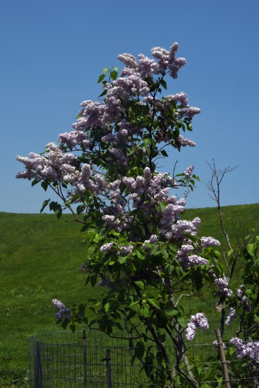
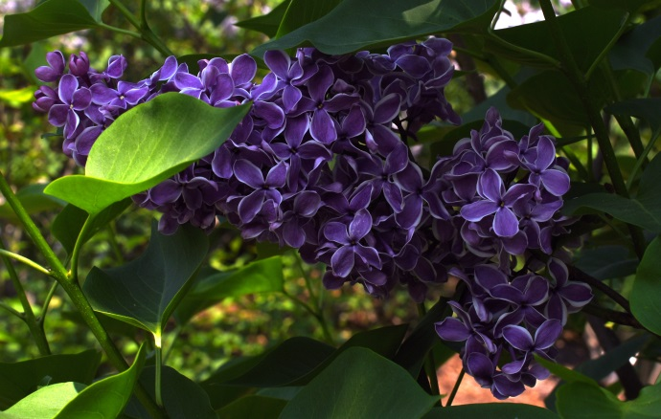
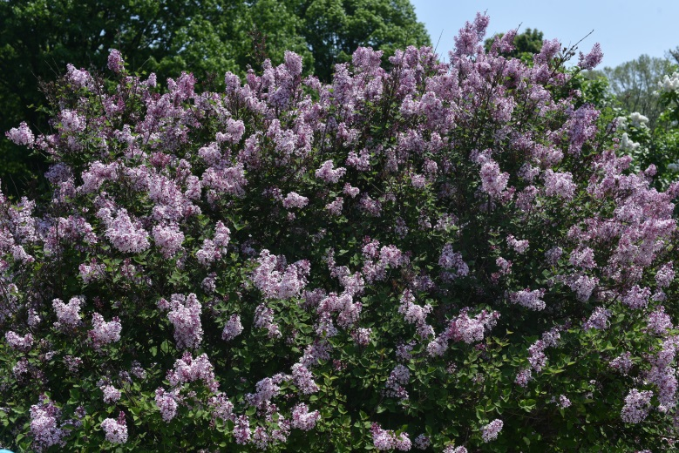
Colophon
These slides were prepared using the Cambria typeface. Mathematical equations use Times New Roman, and source code is presented using Consolas.
The photographs of flowers and a monarch butter appearing on the title slide and accenting the top of each other slide were taken at the Royal Botanical Gardens in October of 2017 by Douglas Wilhelm Harder. Please see
https://www.rbg.ca/
for more information.

Slide 13
Disclaimer
These slides are provided for the ne 112 Linear algebra for nanotechnology engineering course taught at the University of Waterloo. The material in it reflects the authors’ best judgment in light of the information available to them at the time of preparation. Any reliance on these course slides by any party for any other purpose are the responsibility of such parties. The authors accept no responsibility for damages, if any, suffered by any party as a result of decisions made or actions based on these course slides for any other purpose than that for which it was intended.

